Slide 1
PET SITTER
MOHAMED ASHRAF ALI – 20BCE1630
SANJIL KC – 20BCE1855
LENIN VASAN – 20BCE1892

Slide 2
DEVICE AVAILABILITY
Hardware:
NEO-6M GPS Module
Arduino UNO
Antenna

Slide 3
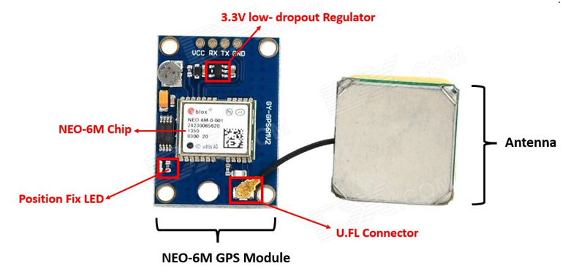
DEVICE SPECIFICATIONS

Slide 4
DEVICE SPECIFICATIONS
The NEO-6M GPS module is a GPS receiver that can locate all locations on Earth as it is able to track approximately 22 satellites. It consists of a high-performance u-blox 6 positioning engine. Measuring 16 x 12.2 x 2.4 mm, its compact architecture along with its low power consumption makes it a good choice for IoT projects. Overall it is a good cost-effective GPS receiver.

Slide 5
DEVICE SPECIFICATIONS
NEO-6M GPS Chip
In the middle of the GPS module, you can find the NEO-6M chip. This is responsible for tracking up to 22 satellites and any location on the Earth on several channels. Due to its highly sensitive tracking nature, it makes the NEO-6M module a popular GPS tracker.
Some key features of NEO-6M chip include:
High sensitivity for tracking
Low supply current (~45mA)
Is able to track 5 locations per second with an accuracy of 2.5m (horizontal).
Comes equipped with PSM also known as Power Saving Mode. This mode causes very less power consumption by turning the module ON/OFF according to the need.
Great use as GPS trackers in smart watches due to very low power consumption (~11mA)

Slide 6
DEVICE SPECIFICATIONS
Position Fix LED Indicator
Moving ahead, the module comes with a position fix LED indicator. This LED indicates through its blinking effect whether the module is searching for satellites or has already found them. If the LED blinks after every second, then it indicates that the position fix is found. However, if the LED does not blink then the module is still searching for the satellites.
V low-dropout Regulator
The module also comes equipped with a 3.3V LDO regulator (MIC5205). This provides an efficient linear voltage regulation with ultralow-noise output and very low dropout voltage. Additionally, the module is can also tolerate 5V easily so programming it with Arduino is very convenient.

Slide 7
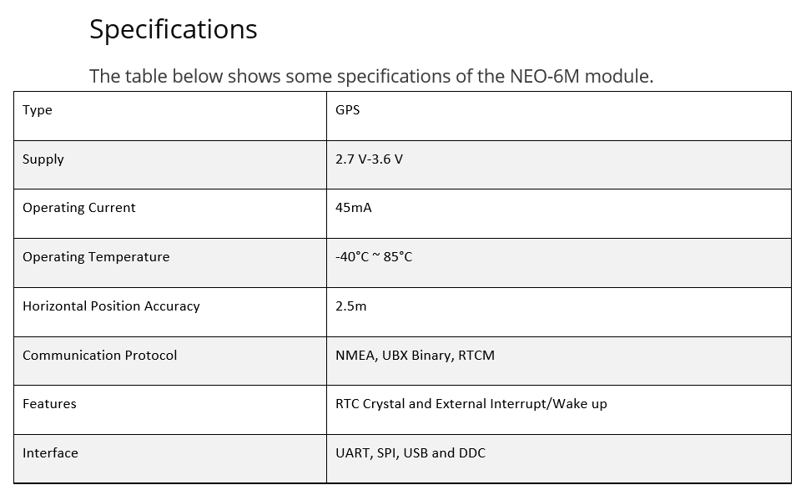
DEVICE SPECIFICATIONS

Slide 8
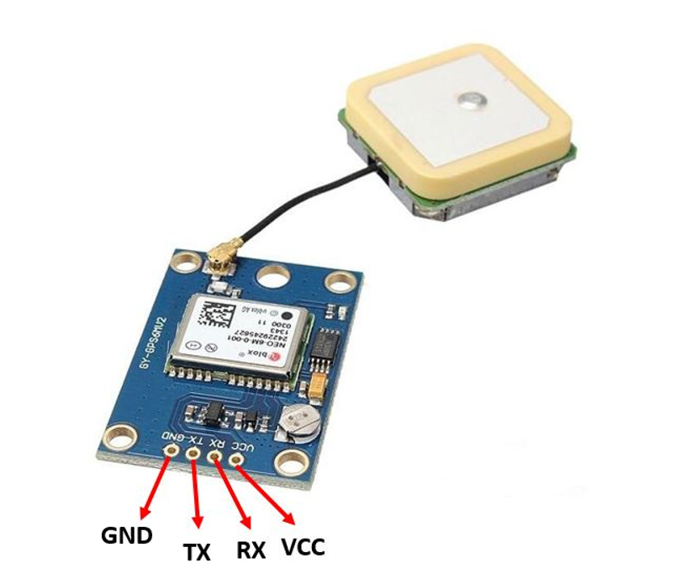
DEVICE SPECIFICATIONS

Slide 9
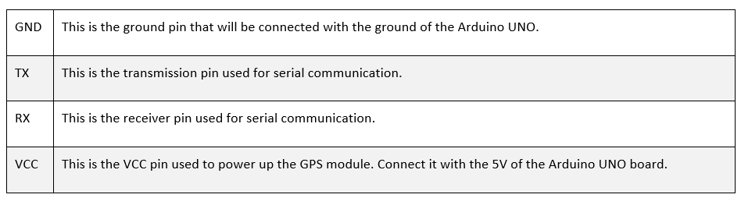
DEVICE SPECIFICATIONS

Slide 10
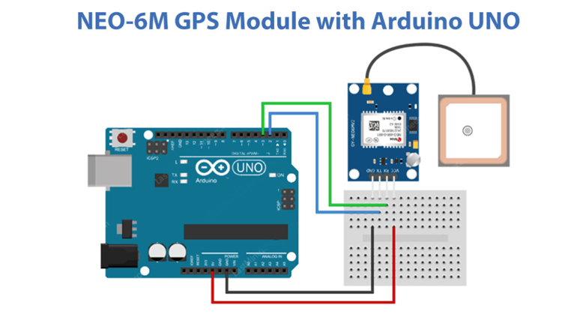
DEVICE SETUP
Hardware Photo:

Slide 11
DEVICE SETUP
Wiring a NEO-6M GPS Module to an Arduino
Now that we know everything about the module, we can start connecting it to our Arduino.
Begin by connecting the patch antenna to the U.FL connector. You can thread the U.FL cable through one of the mounting holes.
The module usually comes with unsoldered header pins. So you will need to solder them first.
Next, connect the VCC pin to the 5V pin on the arduino and GND to ground.
Finally connect the Tx and Rx pins on the module to digital pins #2 and #3 respectively.

Slide 12
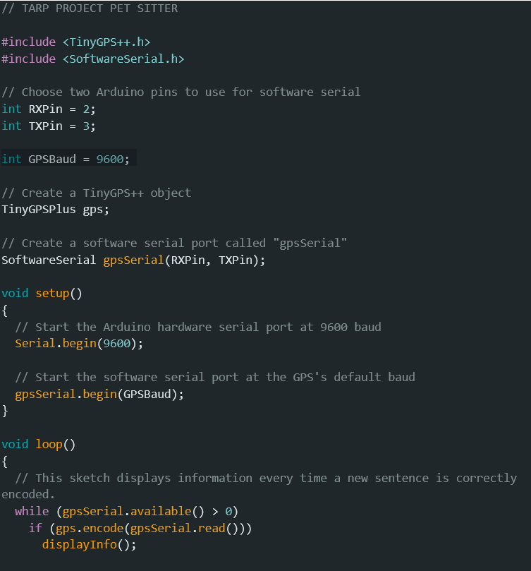
SOFTWARE CODING
1) Code:

Slide 13
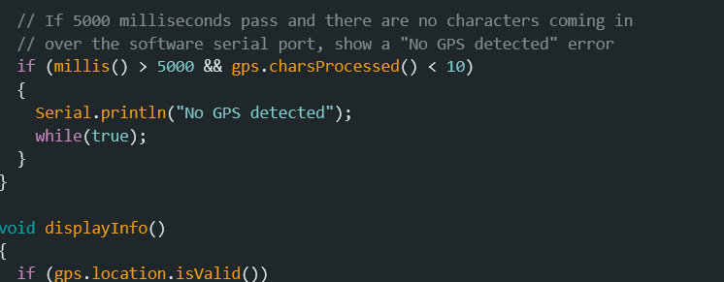
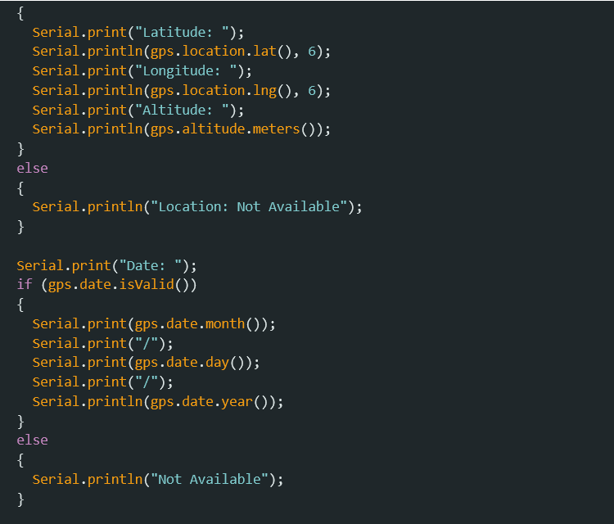
SOFTWARE CODING

Slide 14
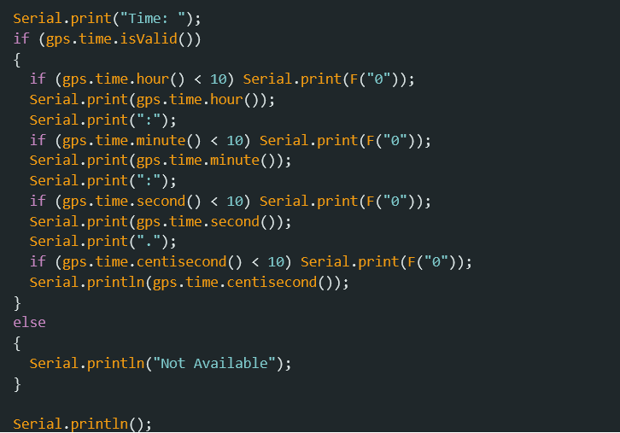
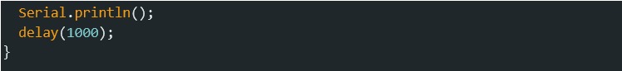
SOFTWARE CODING

Slide 15
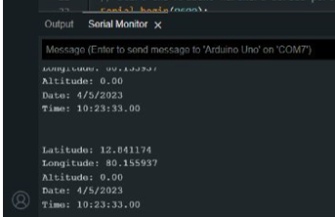
COMPUTER SCIENCE ASPECT AND FUNCTIONAL
OUTPUT:

Slide 16
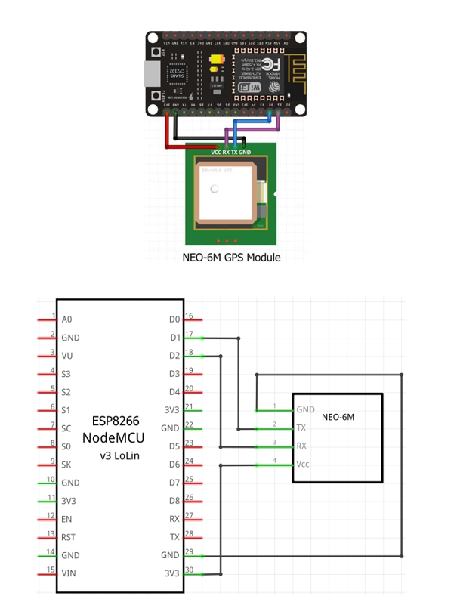
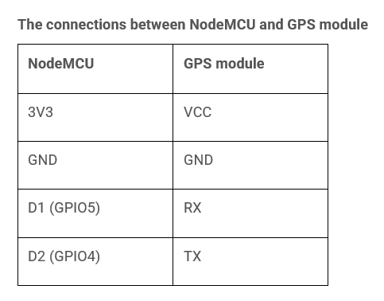
DEVICE SETUP
Hardware Photo:

Slide 17
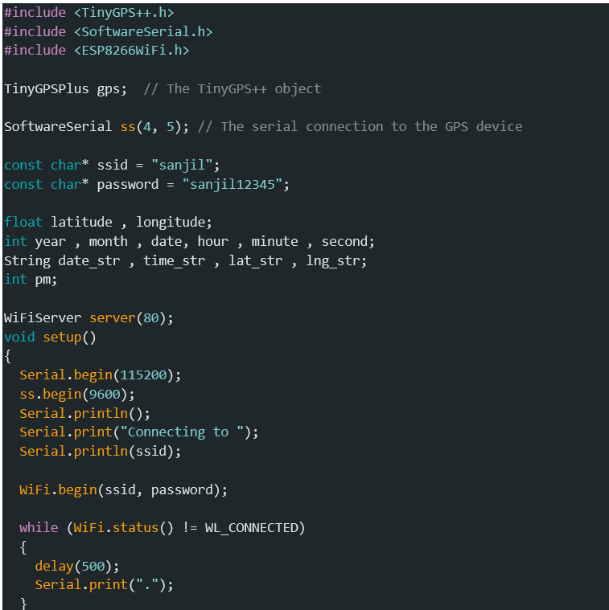
SOFTWARE CODING
2) Code:

Slide 18
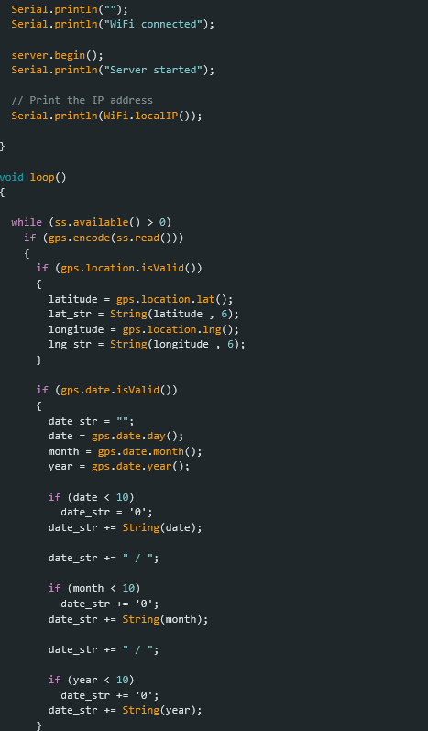
SOFTWARE CODING

Slide 19
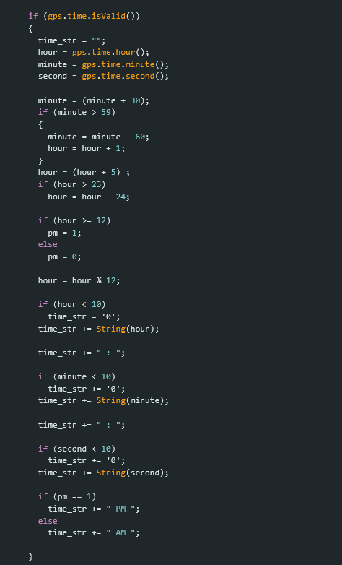
SOFTWARE CODING

Slide 20
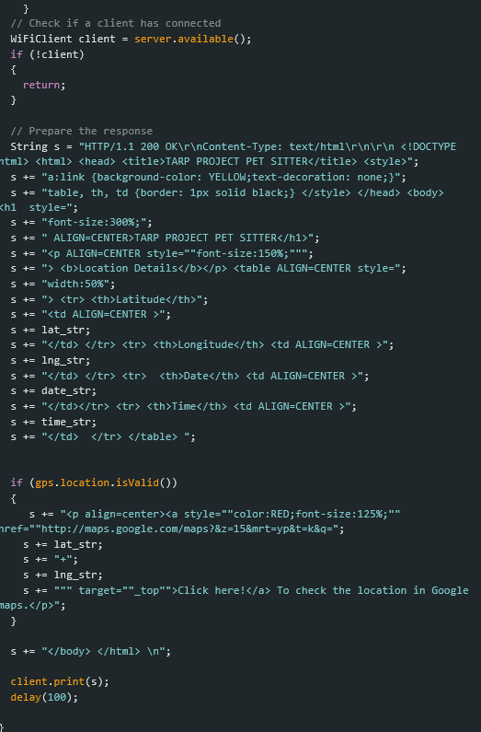
SOFTWARE CODING

Slide 21
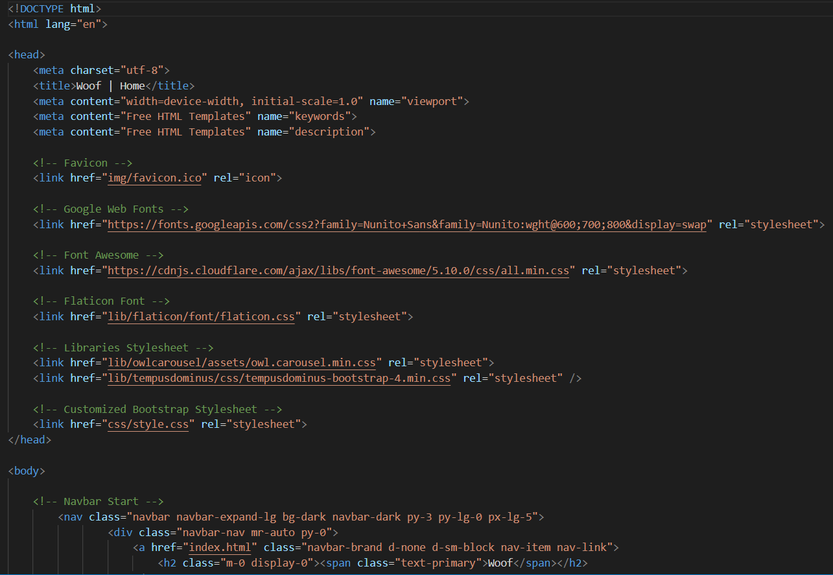
WEB SITE SOFTWARE CODING
SAMPLE INDEX PAGE CODE:

Slide 22
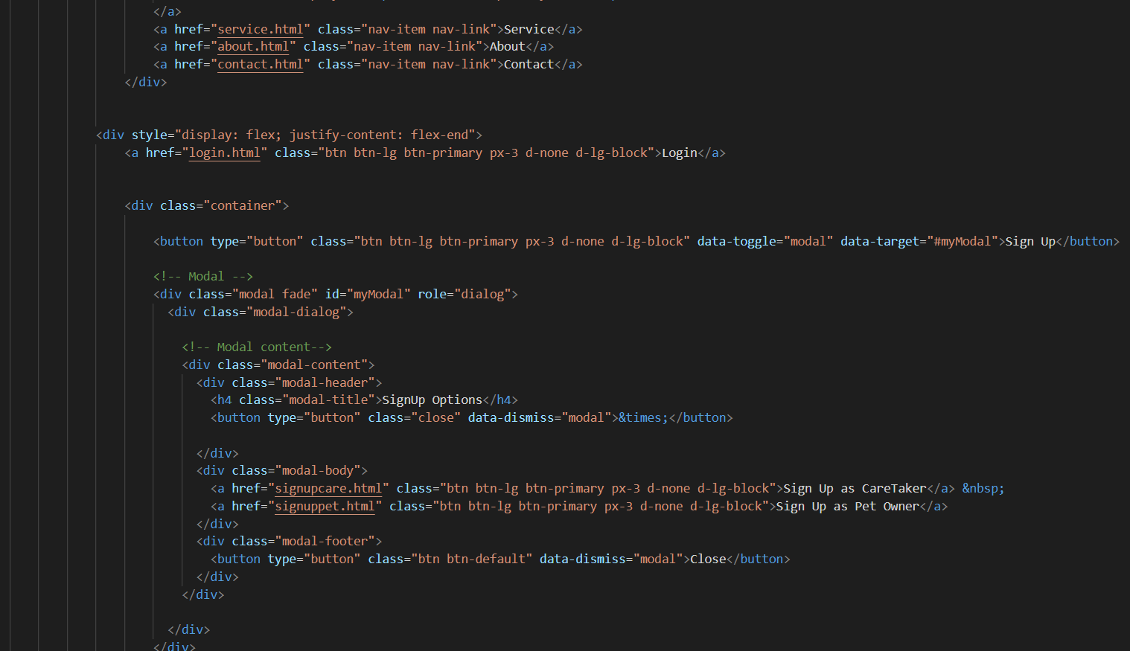
SOFTWARE CODING

Slide 23
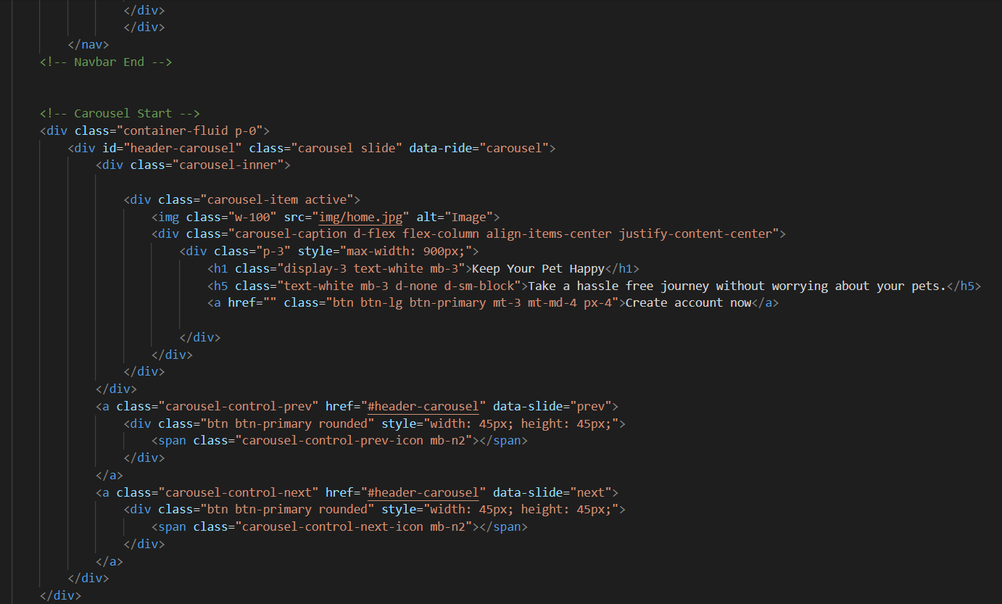
SOFTWARE CODING

Slide 24
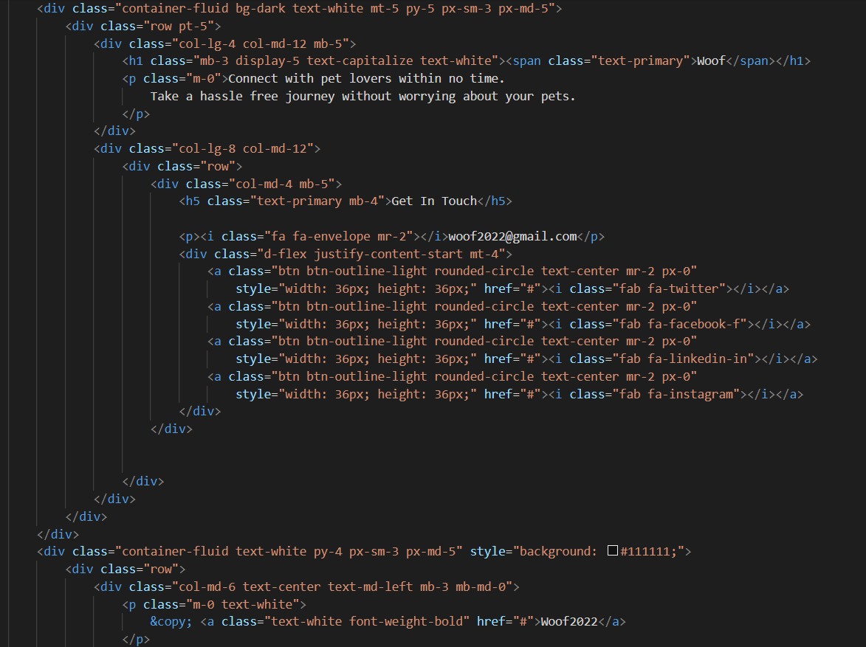
SOFTWARE CODING

Slide 25

SOFTWARE CODING

Slide 26

OUTPUT

Slide 27

THANKS!

